Slide 1
BDD (Behavior-driven development) Using XFramium
[17/09/2018]

Slide 2
What is BDD?
Behavior-driven development (BDD) is a software development methodology in which an application is specified and designed by describing how its behavior should appear to an outside observer.
The main features of BDD are,
Outside-In approach.
Tests are written in common language, which all members in our cross functional teams understand.
Tests are explained as behavior of application and are more user focused.
It uses examples to clarify the requirements.
The same file serves as a documentation for future reference.

Slide 3
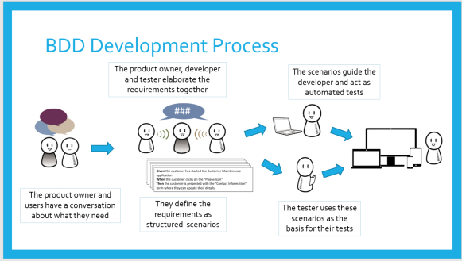
BDD Development Process

Slide 4

cucumber
XFramium uses Cucumber for integrating the BDD feature
Cucumber is a testing tool that supports Behavior Driven Development (BDD) framework. It defines application behavior using simple English text, defined by a language called Gherkin

Slide 5
Gherkin
Gherkin provides the common set of keywords in English text, which can be used by people amongst the different community and yet get the same output in the form of test scripts.
The Gherkin library contains the following parts.
Feature file : Software specification written in Gherkin syntax. Feature files are human-readable specifications that are also machine-readable.
Feature file consists of,
Feature: Standalone unit or functionality of a project. E.g. User Authentication
Scenario: Represents a scenario under a feature. There can be multiple scenarios under a feature. E.g. Login, Logout
Steps: Each scenario can have multiple steps. Each step is preceded with a Keyword that relates the step with the Step Definition. E.g. “Given I am on google“, “When I searched for Allstate”, “Then the search result has ‘10000’ items”.

Slide 6
Step Definition contd..
A Step Definition is a Java method with an expression that links it to one or more Gherkin steps. When Cucumber executes a Gherkin step in a scenario, it will look for a matching step definition to execute.
@When("^I click on retrieve quote link$")
public void clickOnRetrieveQuote(WebDriver driver){
wPage.clickRetrieveQuote();
}
Feature File Example
Feature: Retrieve Quote Window Availability
Scenario: Check the availability of window
Given I am on AOS home page
When I click on retrieve quote link
Then New window should be available

Slide 7
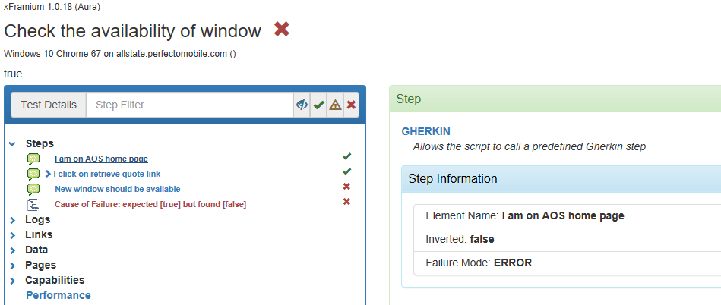
Additional features provided by XFramium
XFramium allows us to optionally inject the WebDriver, SuiteContainer, ExecutionContextTest in to the step definition, there by reducing the effort in creating step definition.
XFramium overrides the default reporting and provides a detailed description of the steps involved.

Slide 8

Demo

Slide 9


